Slide 1
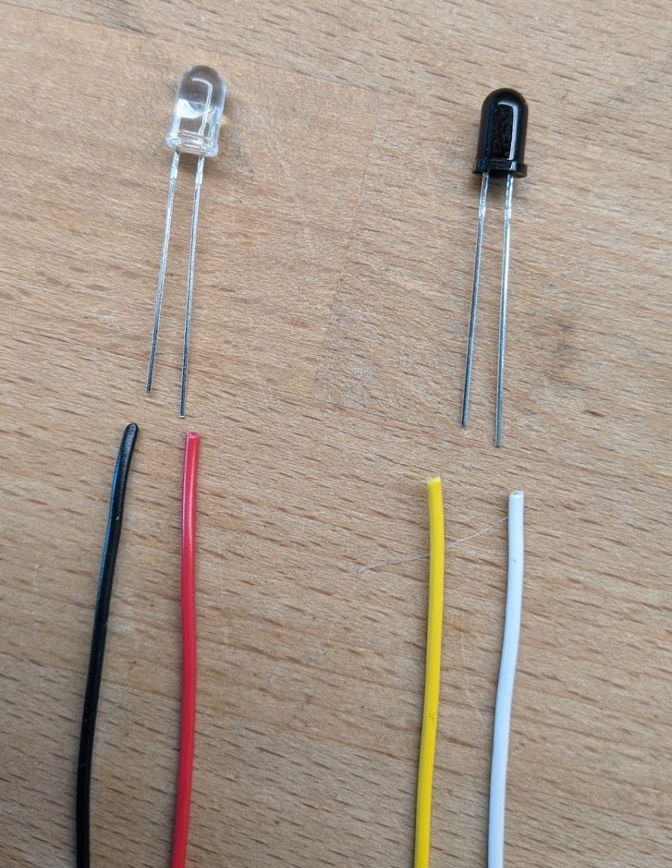
Wiring IR Emitter/Detectors
The CLEAR LED is the Emitter.
Our circuit sends about 17ma of current through this device.
The RED wire carries positive voltage and must be connected to the LONG lead.
The BLACK wire should be connected to the SHORT lead.
Use 24-26 AWG stranded wire.
The Dark Component is the Detector.
When it detects IR light, it allows
current to flow between it’s leads, but
in only one direction: from the short lead
to the long lead.
The YELLOW wire is the positive side and
Must be connected to the SHORT lead.
The WHITE wire is the negative side and
Must be connected to the LONG lead.

Slide 2
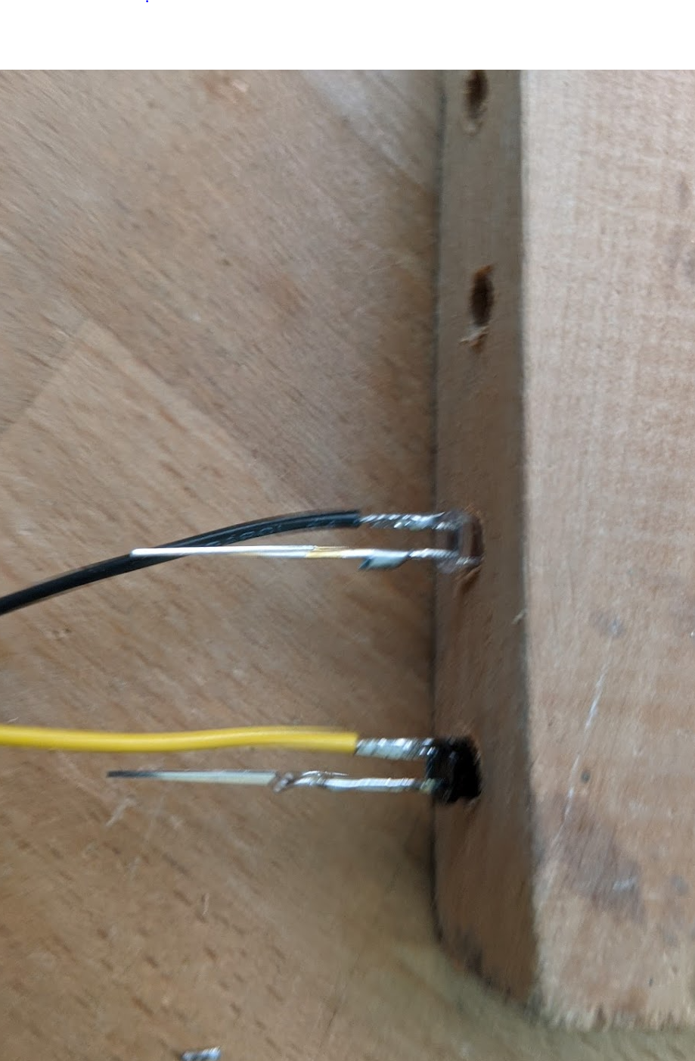
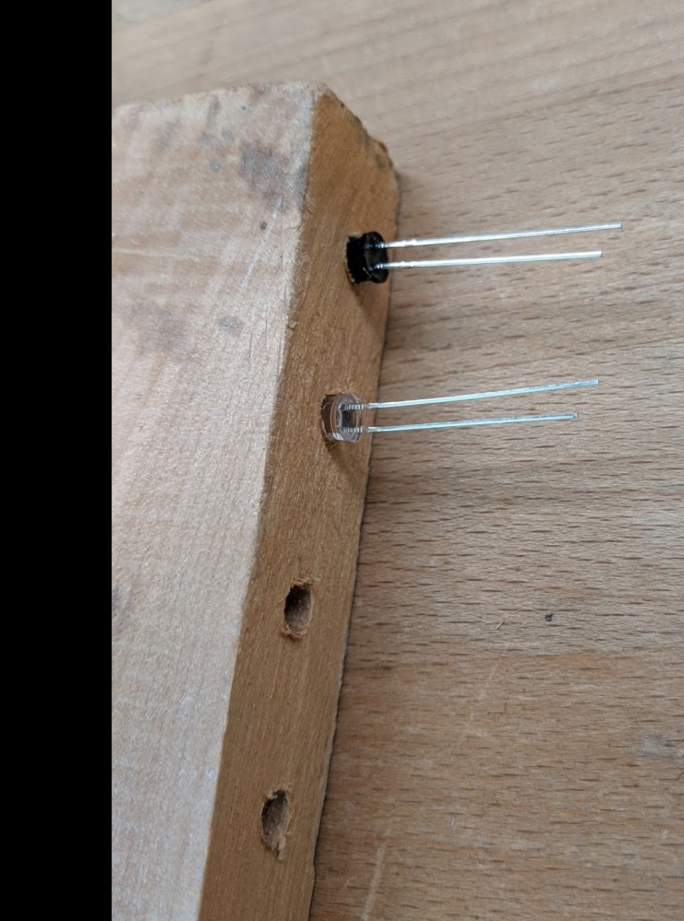
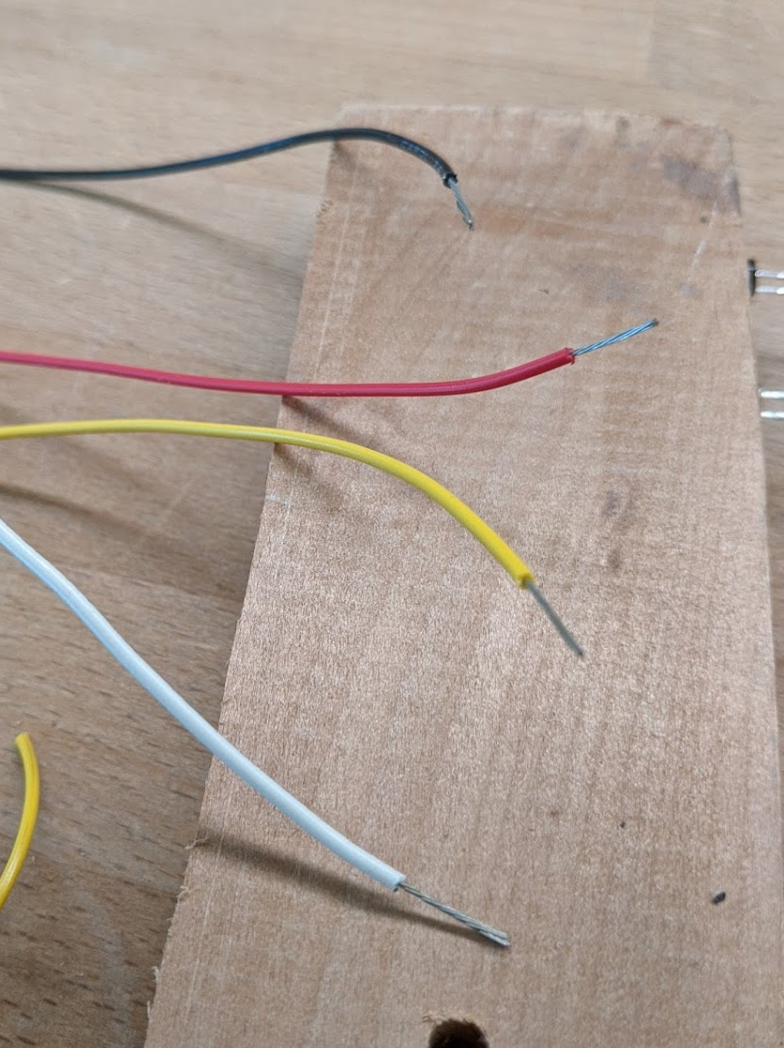
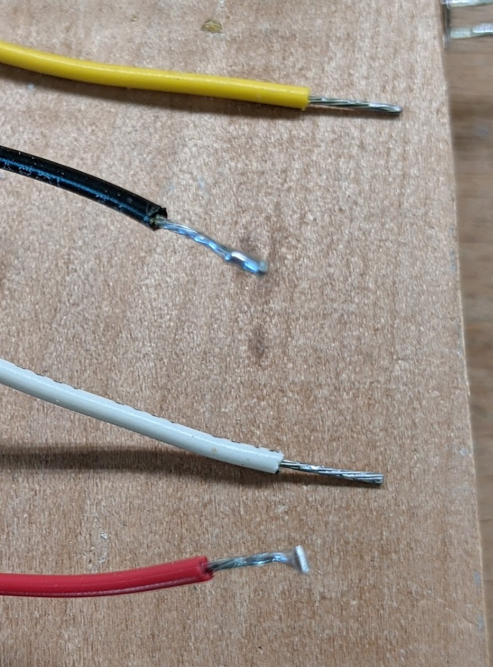
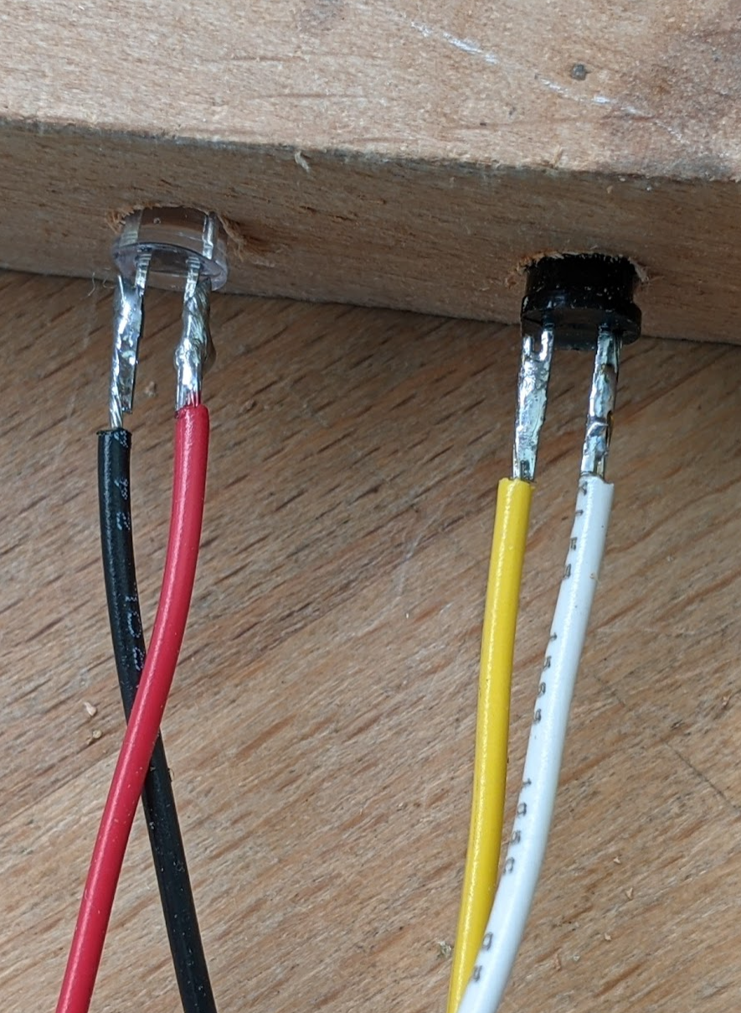
Steps to Solder Wires to the IR Components
Start with the components in the soldering jig with the long leads nearer the top of the jig.
Strip about 0.5 inch of insulation from each wire.
Tin all wires and leads. Then trim the wires so that there is about 3/8 inch of conductor showing.
Cut the short leads to about 3/8 inch. And then use the parallel solder technique to solder the wires.
Do the same for the long leads.
Parallel solder technique: After tinning both wire and lead, bring the wire along side of the lead (i.e., parallel to it), and then heat both with the soldering iron at the same time. Allow the solder to flow between the lead and the wire while holding the wire very steady. Remove the soldering iron while keeping the wire absolutely still until the solder cools.

Slide 3
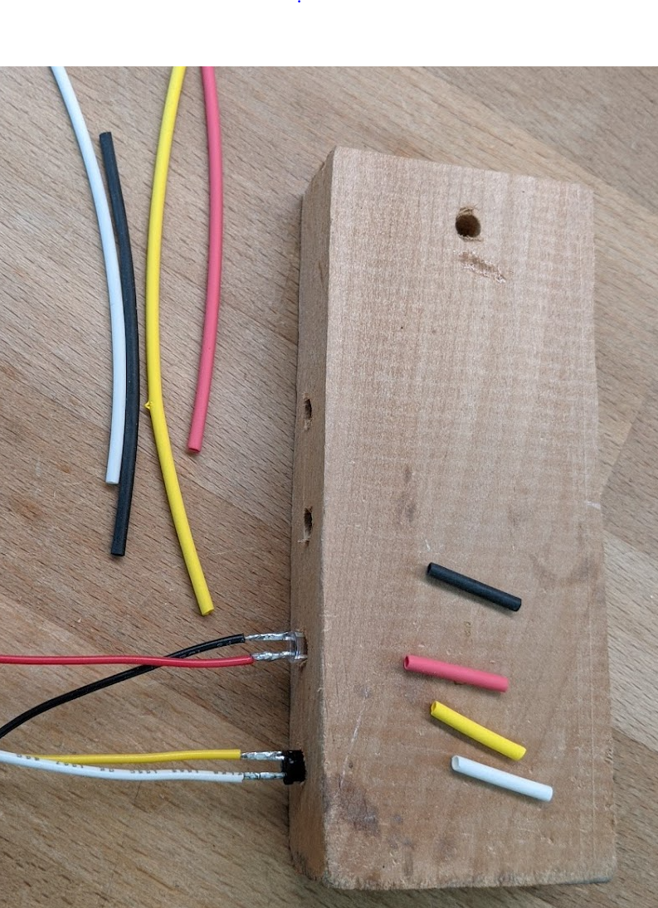
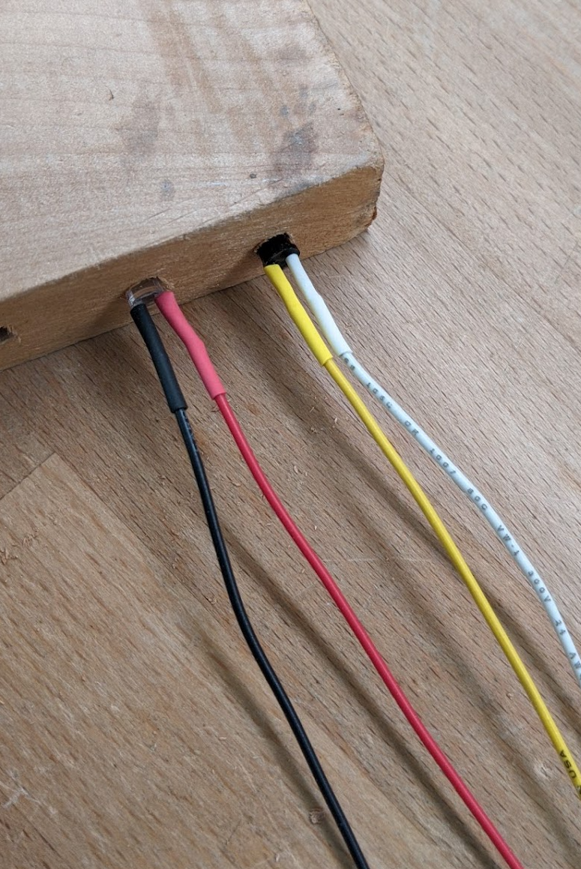
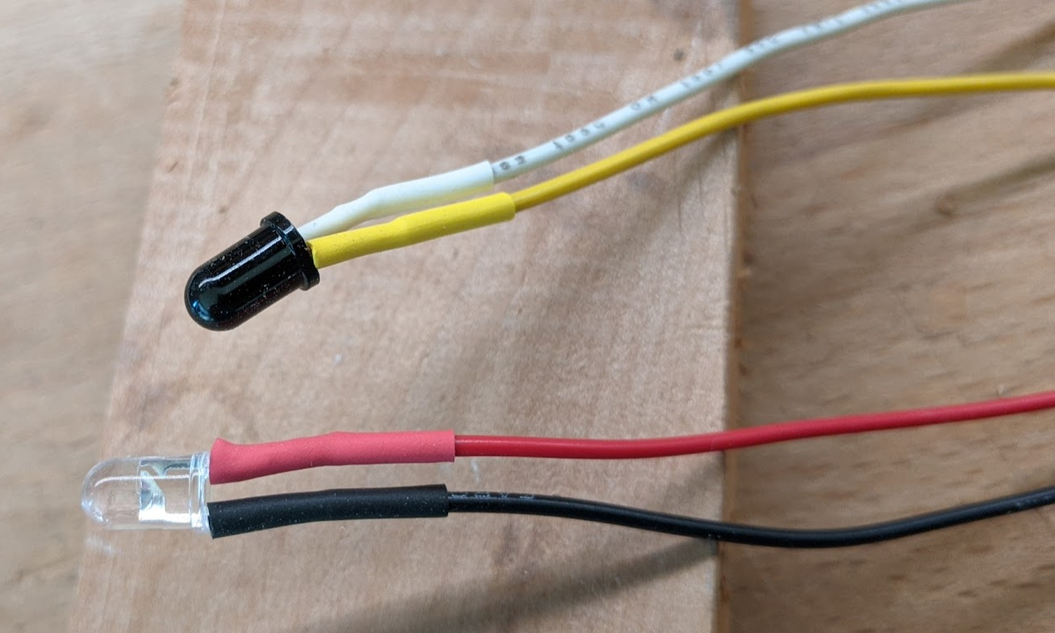
Steps to Finish the Soldered IR Components
Cut about 5/8” of heat shrink tubing for each wire. Try to use the same color. Use 1/16 “ diameter tubing (measured before heat applied).
Slide the heat shrink tubing on each wire all the way to the component. Apply heat with a heat gun. Don’t use a match!
All Done!

